Slide 1
ITEC-660 BUSINESS INTELLIGENCE
An Analysis of Enrollment
by Varying Lead Categories
Chidi Agbaeruneke, Ifebunandu (Jerome) Okeke,
Shaun Villanueva-Unger, Reina Villanueva-Unger,
Shijian (Oliver) Zhu, Qianru Zhang, Yicen (Ethan) Wang
Notes:
Reina

Slide 2
ITEC-660 BUSINESS INTELLIGENCE
Key Presentation Points
Leads, Enrollments, & the Costs Involved
The Five Major Spending Categories
The Role of Education and Region
Our Path Forward
Dashboard Overview
Q&A
What is on the agenda?
Notes:
Reina
To kick off our presentation, Ethan and Oliver will give us a brief snapshot of our leads and enrollment numbers. Shaun will then give us additional insight on which channels overall are generating enrollments and which channels overall are costing us the most money per enrollment. After that, Jerome, Shaun, Ethan, Chidi, and Qianru will drill down on our five highest spending categories and their performances. Oliver and Chidi will then discuss the impact of education level and region on enrollment numbers. Finally, I will be back with our recommendations for moving forward and to take you for a test drive of our Tableau dashboard.
Reina
To kick off our presentation, Ethan and Oliver will give us a brief snapshot of our leads and enrollment numbers. Shaun will then give us additional insight on which channels overall are generating enrollments and which channels overall are costing us the most money per enrollment. After that, Jerome, Shaun, Ethan, Chidi, and Qianru will drill down on our five highest spending categories and their performances. Oliver and Chidi will then discuss the impact of education level and region on enrollment numbers. Finally, I will be back with our recommendations for moving forward and to take you for a test drive of our Tableau dashboard.

Slide 3
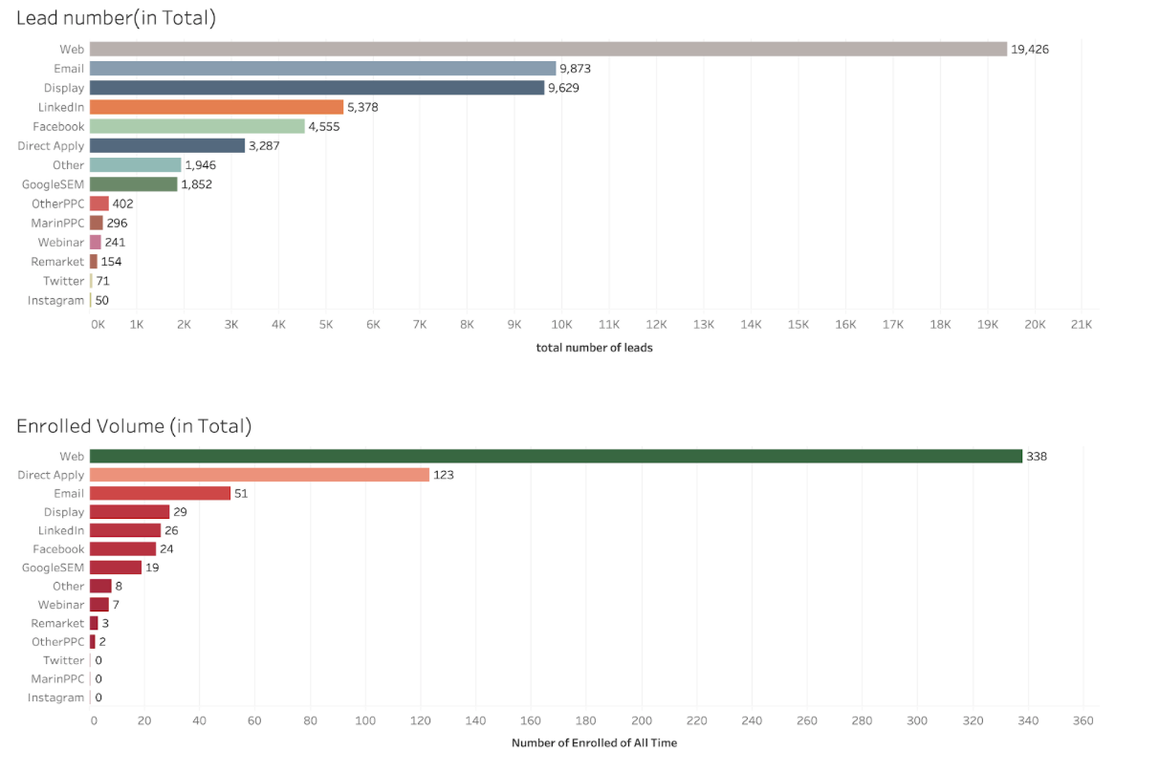
ITEC-660 BUSINESS INTELLIGENCE
Number of Leads vs Enrollments
Web Outperforms All Categories
Web, Email, Display, Linkedin, Facebook and GoogleSEM effectively obtain leads. Many of these leads result in large number of enrollments.
Notes:
Ethan and Oliver
As can tell in the two graphs, web is our best lead generator as well as best enroll generator. The number of that is much higher than other generators in these two graphs
Web, Email, Display, Linkedin, Facebook and GoogleSEM can be considered effective resources of leads. Large number of leads results in large number of enrolled.
Direct Apply is also effective, it ranks in 6th in lead number and ranks in second in enrolled volume.
Based on our data, old fashion way of web, email and direct apply is still the mostly used and effective way. Social media such as Facebook and Linkedin is worth putting money in but Twitter and instagram is not worthy.

Slide 4
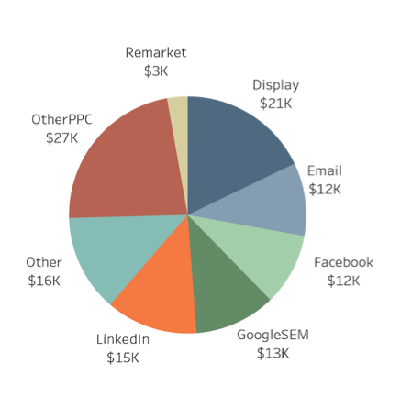
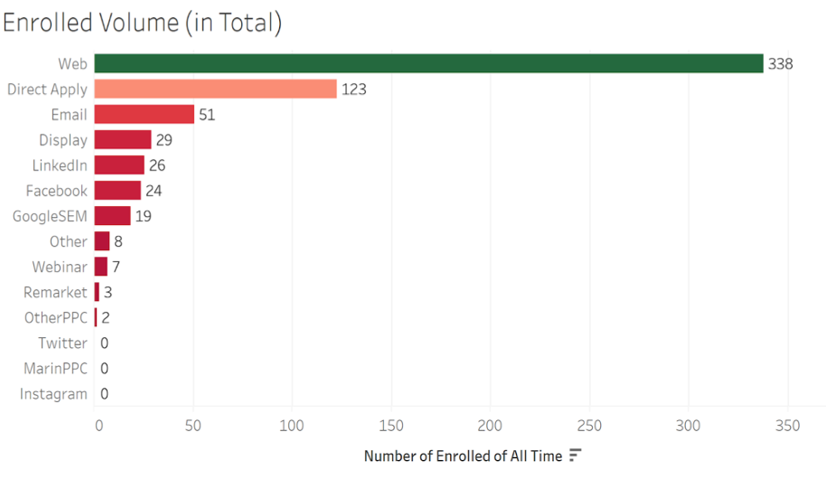
2021 CONTENT STRATEGY PLANNING
Enrollments
Cost vs Volume
Notes:
Shaun
Our best lead generator is web as well as the best enrollment generator, which consisted of mostly bachelors and masters enrollments
We have 5 high spend categories yielding very low enrollment, and three categories with high enrollment costing $0. Most our current spend categories are not worth keeping and money should be relocated
Based on the data our suggestion is to shift some money to social media, but only on the east coast and west coast while also putting more money into our $0 cost categories

Slide 5
ITEC-660 BUSINESS INTELLIGENCE
The Five Major Spending Categories
How effective are our dollars?
Notes:
Jerome

Slide 6
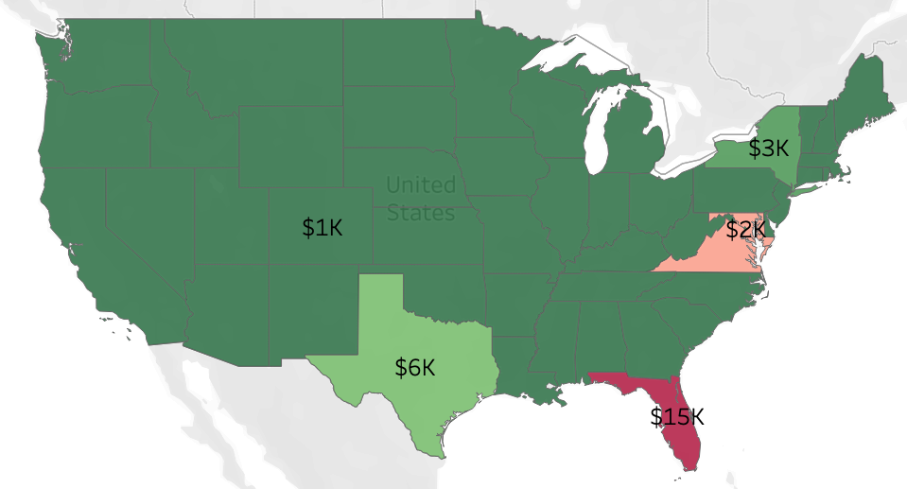
ITEC-660 BUSINESS INTELLIGENCE
GoogleSEM
Cost per Enrolled by State
Notes:
Jerome
Total cost is $248k in this category
Cost per enrolled in this category is 13k
Most dollars spent is in FL at $15k
4 people enrolled from DC at the cost of only $2k
Lowest number of leads generated is 7 in Q4 of 2013 and the most leads generated is 184 in Q4 of 2015.
At $13k cost per enrolled, it is slightly above the threshold of $12k. Although it does have some enrollment, Resources in places like Florida with cost of $15k per enrollment should be reallocated to other lead source like remarketing .

Slide 7
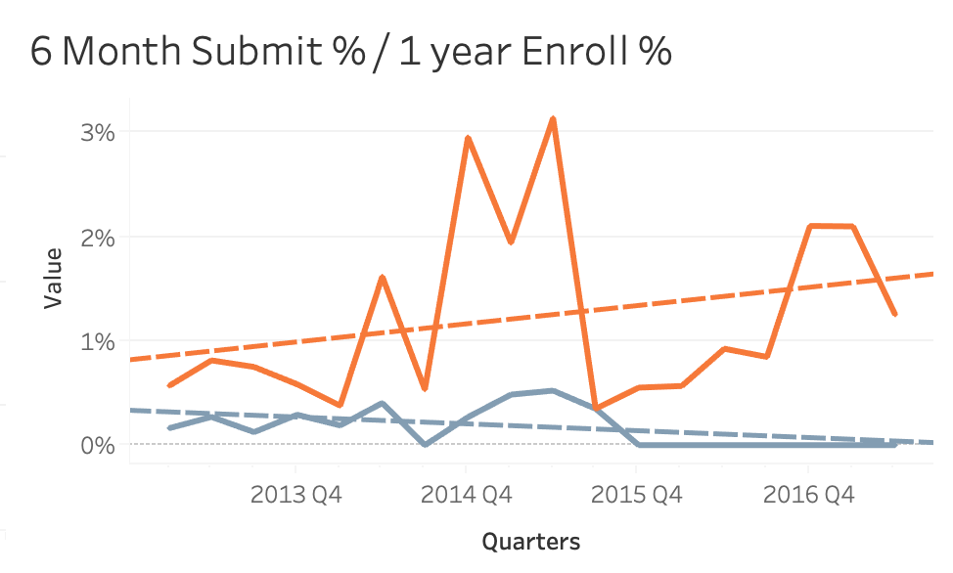
ITEC-660 BUSINESS INTELLIGENCE
GoogleSEM Over Time
Submissions vs Enrollments
Display was actually a less efficient lead resource before Q4 2014 and become more efficient afterwards.

Slide 8
ITEC-660 BUSINESS INTELLIGENCE
GoogleSEM
The Least Effective
$15k
$9k
Cost per Enrollment in Florida
Cost per Enrollment in Virginia and Maryland
Notes:
Jerome

Slide 9
ITEC-660 BUSINESS INTELLIGENCE
GoogleSEM
The Most Effective
$1k
$3k
Cost per Enrollment in Colorado
Cost per Enrollment in Texas
Notes:
Jerome

Slide 10
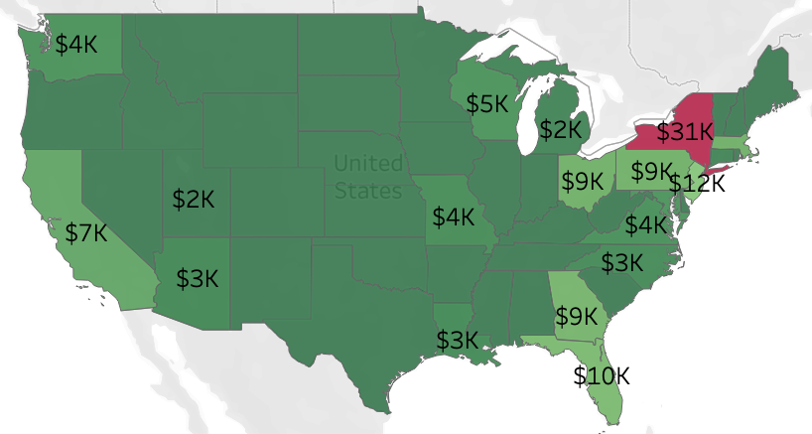
ITEC-660 BUSINESS INTELLIGENCE
Email
Cost per Enrolled by State
Notes:
Chidi
Total cost of the category: $599K
Of all Narrow Lead Categories that have costs associated with enrolled students, Email is tied for second for lowest cost at $12K.
Efficiency comparison of spend: Least efficient (NY, $31K per one enrolled) vs Most efficient (DC, $3K per 6 enrolled)
Least leads: Q2 2017 (58) vs Most Leads: Q1 2014 (1458)
General pattern of a drop is persistent in Q3 annually for percentage of Apps submitted and enrolled. However, a positive trend is present year over year.

Slide 11
ITEC-660 BUSINESS INTELLIGENCE
Email
The Least Effective
$31k
$12k
Cost per Enrollment in New York
Avg. Cost per Enrollment for Email
Notes:
Chidi

Slide 12
ITEC-660 BUSINESS INTELLIGENCE
Email
The Most Effective
$2k
$3k
Cost per Enrollment in MI & UT
Cost per Enrollment in AZ, LA, & NC,
Notes:
Chidi

Slide 13
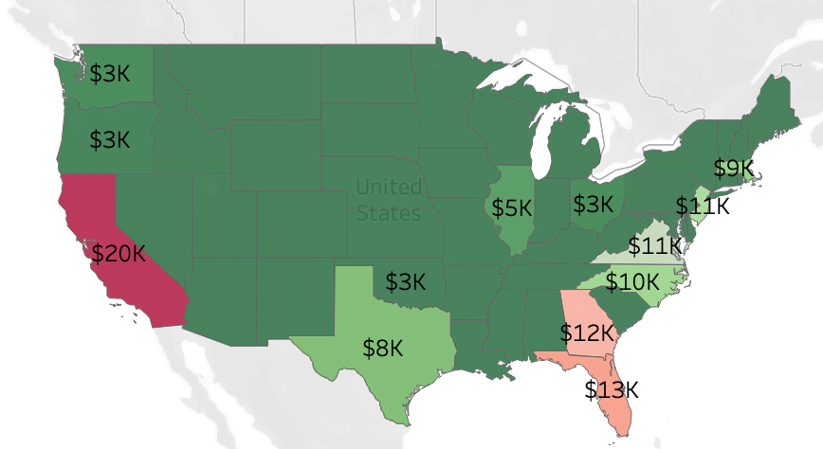
ITEC-660 BUSINESS INTELLIGENCE
Display
Cost per Enrolled by State
Notes:
Ethan
Total cost for this category is $610K with cost per enrolled of $21K.
Most dollars spent is in CA at $20k but only 2 people actually enrolled. Cost per enrolled for CA is $10K.
3 people enrolled from DC at the cost of only $3k, which can be considered best to allocate money on Display.
Lowest number of leads generated is 95 in Q4 of 2016 and the most leads generated is 2395 in Q3 of 2013.
Display does have some enrollments, but for states like CA,GA,NJ, with cost per enrollments of $10K, $12K, $11K, resources should be allocated.
For time-series performance of lead sources of Display, before Q4 2014, with high number of leads generated, the 6 Month Submit% and 1 year Enroll% are really low and not complied with volume generation time series. However, after Q4 2014, with lower number of leads generated, 6 Month Submit% and 1 Year Enroll is actually improved and complied with lead volume generation time series, which indicates that Display is actually a less efficient lead resource before Q4 2014 and become more efficient afterwards.

Slide 14
ITEC-660 BUSINESS INTELLIGENCE
Display
The Least Effective
$20k
$13k
Cost per Enrollment in California
Cost per Enrollment in Florida
Notes:
Ethan

Slide 15
ITEC-660 BUSINESS INTELLIGENCE
Display
The Most Effective
$3k
$5k
Cost per Enrollment in OK, OH, OR, & WA
Cost per Enrollment in Illinois
Notes:
Ethan

Slide 16
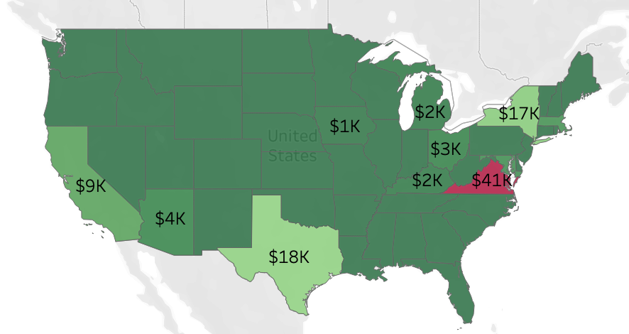
ITEC-660 BUSINESS INTELLIGENCE
Facebook
Cost per Enrolled by State
Notes:
Qianru
Total cost in this category is $278 K with cost per enrolled of $12K.
Most dollars spent in VA and the number of application in VA is 1, thus the cost per person in VA is $21K.
The cost in DC is only $6K and the cost per person in DC is only $2K
Lowest number of leads generated is 33 at 2015 Q3.Highest number of leads generated is 533 at 2013 Q1.
Facebook does have certain enrollments but in states like CA, GA, FL and NJ , the cost per enrolled is over $10K. The resource should be allocated in these states.
The overall enrollment stays very low before 2014Q2 and after that the enrollment got to a peak at 2014 Q4 and 2015 Q3, which does not reflect the effect of the lead volume generated at that period.

Slide 17
ITEC-660 BUSINESS INTELLIGENCE
Facebook
The Least Effective
$41k
$12k
Cost per Enrollment in Virginia
Avg. Cost per Enrollment for Facebook
Notes:
Qianru

Slide 18
ITEC-660 BUSINESS INTELLIGENCE
Facebook
The Most Effective
$1k
$2k
Cost per Enrollment in Iowa
Cost per Enrollment in Michigan
Notes:
Qianru

Slide 19
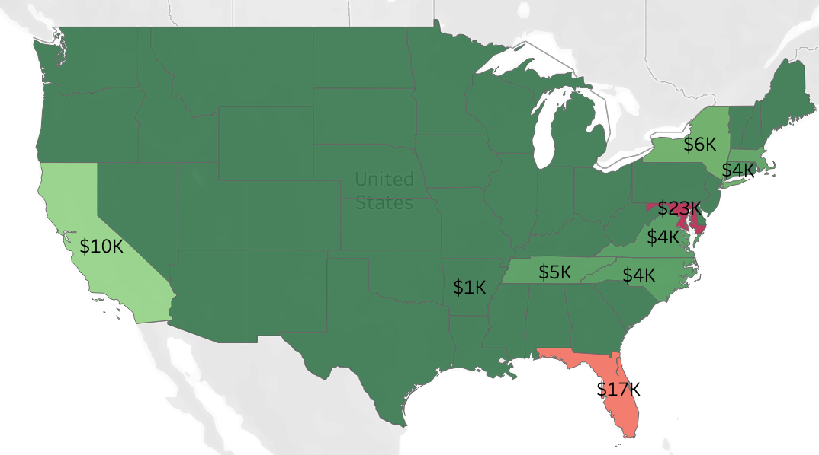
ITEC-660 BUSINESS INTELLIGENCE
LinkedIn
Cost per Enrolled by State
Notes:
Shaun
As you can see overall we are putting $383k towards our Linkedin leads
The cost is $15k per enrolled student through the Linkedin leads, we spent the most in FL and MD through this category and only 1 per enrolled in each state, but spent less in VA and got 8 enrollments
In total this lead category generated 440 applications started but only 26 of those enrolled, a conversion rate of 6%
Our lead volume shows in 2013 Q3 at the highest point we received 563 leads for this category but that has dwindled to less than 100 as end of 2016
While this lead category does produce some enrollments, it is not the most effective and the money should be relocated to a broader audience category

Slide 20
ITEC-660 BUSINESS INTELLIGENCE
LinkedIn
The Least Effective
$23k
$17k
Cost per Enrollment in Maryland
Cost per Enrollment in Florida
Notes:
Shaun
Total cost is $383k towards this category
$15k per enrollment via this category
Most dollars spent in FL at $17k and MD at $23k, 2 enrolled total from them.
8 enrolled from VA spent only $4k there
I440 leads generated, only 26 enrolled, 6% conversion rate
Highest point for leads was 563 leads during 2013 Q3, leads have dropped below 100 as of 2016 Q3
While this lead category does produce some enrollments, it is not the most effective and the money should be relocated to a broader audience category, or relocated to focus on the east coast and bachelors level people

Slide 21
ITEC-660 BUSINESS INTELLIGENCE
LinkedIn
The Most Effective
$1k
$13k
Cost per Enrollment in Arkansas
Avg. Cost per Enrollment for LinkedIn
Notes:
Shaun

Slide 22
ITEC-660 BUSINESS INTELLIGENCE
The Role of Education and Region
How do these factors impact cost?
Notes:
Oliver

Slide 23
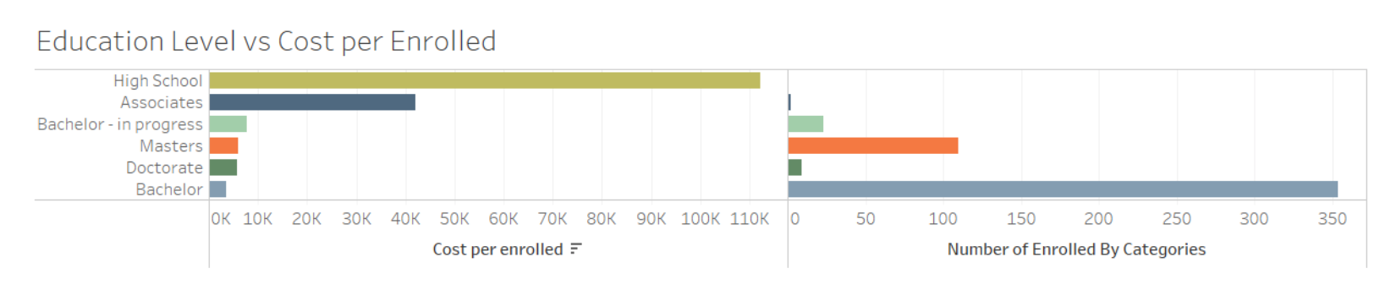
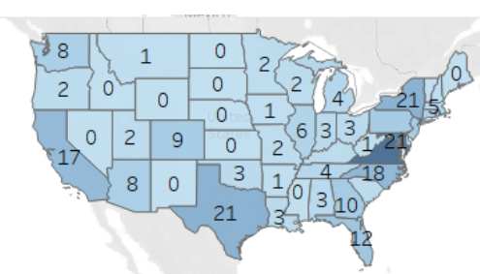
2021 CONTENT STRATEGY PLANNING
Education
Level vs Cost
Notes:
Oliver
Large number in enrollment result in low cost per enrolled.
‘Bachelor’ is the most popular degree in AU, it has the highest number of enrolled. But the least number of cost per enrolled.
‘High School’ has the largest number of ‘Cost per Enrolled’ but the least number of enrolled.
From the map, it’s easier to find that students in VA(52) has the largest number of enrolled. The second largest numbers are in TX and DC(21).

Slide 24
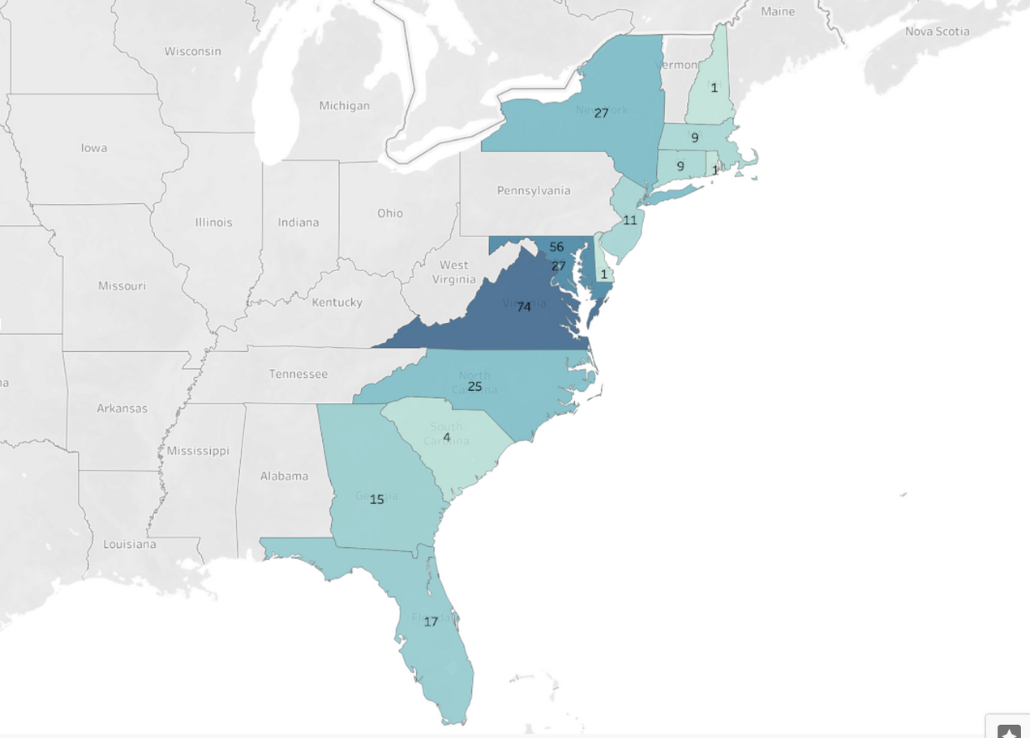
ITEC-660 BUSINESS INTELLIGENCE
Regionally
Where did we get the most enrollments?
The eastern seaboard accounts for approximately 42% of all enrolled students.
Notes:
Chidi
A large percentage of the enrolled students are located along the eastern seaboard.
Comprises of (DC, MD, VA, NH, MA, RI, CT, NY, NJ, DE, NC, SC, GA, and FL)
This region accounts for approximately 42%, or 277 respectively, of all enrolled students.
Within this region, the DMV is responsible for more than half, 157 enrolled students respectively.
The state of Virginia has the largest number of enrolled students with 74.

Slide 25
ITEC-660 BUSINESS INTELLIGENCE
Regionally
Where did we spend the most money?
$10,466
$10,466
1
1
1
1
$8,354
1
1
1
1
Dollars Spent in Kansas
Dollars Spent in Kansas
Enrolled from Kansas
Dollars Spent in Iowa
Enrolled from Iowa
$8,051
2
2
2
2
$7,804
2
2
2
2
Dollars Spent in Minnesota
Enrolled from Minnesota
Dollars Spent in Missouri
Enrolled from Missouri
Notes:
Chidi
When considering Cost Per Enrolled student, the states of Kansas ($10,466), Iowa ($8354), Minnesota ($8051), and Missouri ($7804) top the list.
On the basis of enrolled students these Midwestern states also yield some of the lowest quantities of enrolled students, Kansas (1), Iowa (1), Minnesota (2), and Missouri (2).

Slide 26
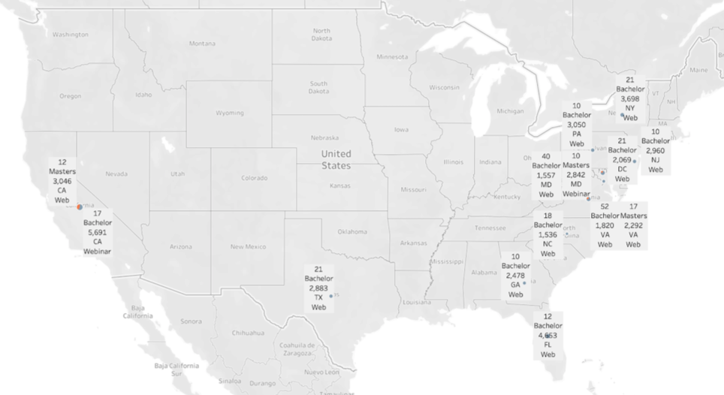
ITEC-660 BUSINESS INTELLIGENCE
Efficiency of Spend
By Lead Category & Education Level
The Bachelor and Masters groups account for the areas of most effective spend.
Notes:
Chidi
The Bachelor and Masters groups account for the areas of most effective spend.
The states depicted on the map alongside their respective numbers for enrolled students, distinguished by education level, and average cost per enrolled student capture approximately 42% of all enrolled students, 271 out of 652.
The two most effective lead categories associated with this large percentage are Web and Webinar.

Slide 27
ITEC-660 BUSINESS INTELLIGENCE
Our Path Forward
Where do we go from here?
Notes:
Reina

Slide 28

ITEC-660 BUSINESS INTELLIGENCE
Recommendations
GoogleSEM
Email
Display
Move funds spent in Florida, Maryland, and Virginia to Colorado and New York.
Move funds spent in New York to Michigan and Utah.
Move funds spent in California, Florida, and Georgia to Oklahoma, Ohio, Oregon, and Washington.
Facebook
LinkedIn
Bachelor Degrees
Move funds spent in Virginia to Iowa and Michigan
Move funds spent in Maryland and Florida to Arkansas.
Move funds spent on High School students to target those with Bachelor and Masters Degrees.
Notes:
Reina

Slide 29
ITEC-660 BUSINESS INTELLIGENCE
Tableau Dashboard Overview
Let's see it in action!
Notes:
Reina

